Slide 1











Notes:
Erin (as people join)
5min 1:00-1:05

Slide 2
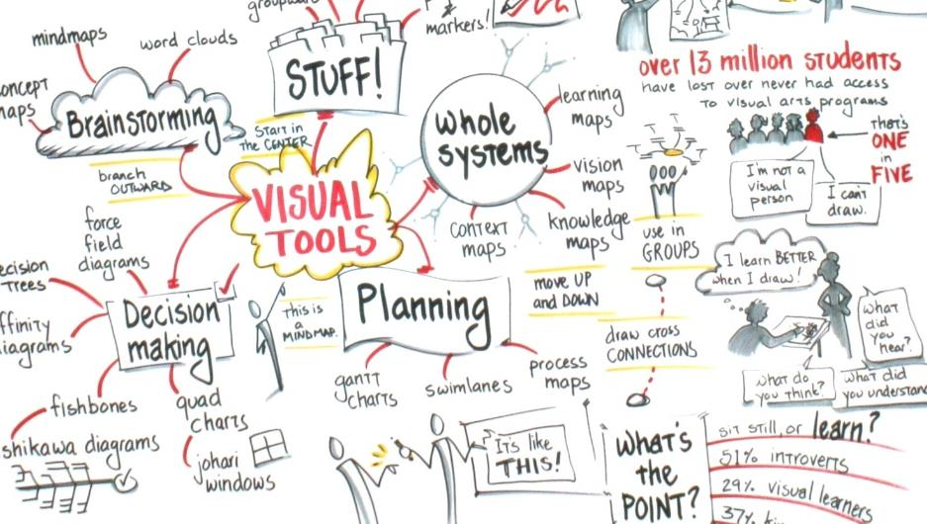







Notes:
Erin
1min 1:05-1:06

Slide 3
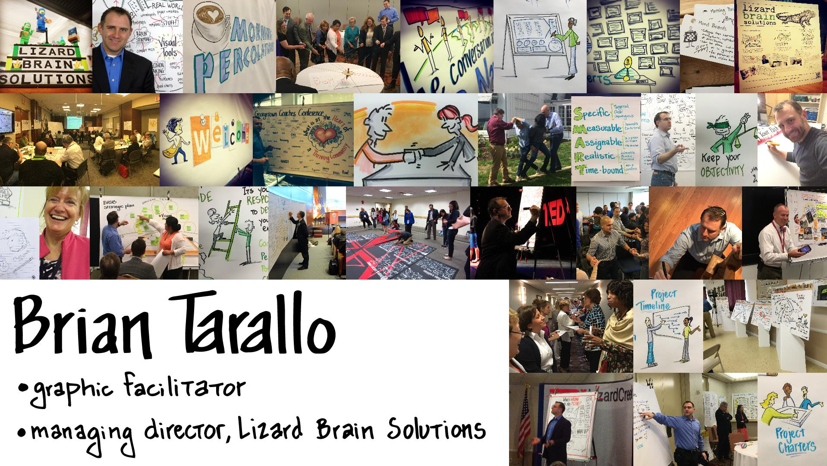
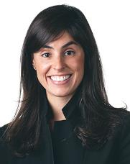
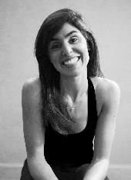

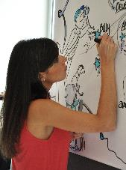





Notes:
Brian
1min 1:06-1:07

Slide 4









OBJECTIVE: Build your virtual facilitation skills
AGENDA:
  Basics of GlobalMeet (ReadyTalk)
  Virtual facilitation principles
  Virtual facilitation tools
  If you have an hour…
  PowerPoint best practices
  Facilitation ethics and values
  Facilitating through questions
  Maintaining engagement
  Resources
Notes:
Erin
2min 1:07-1:09

Slide 5




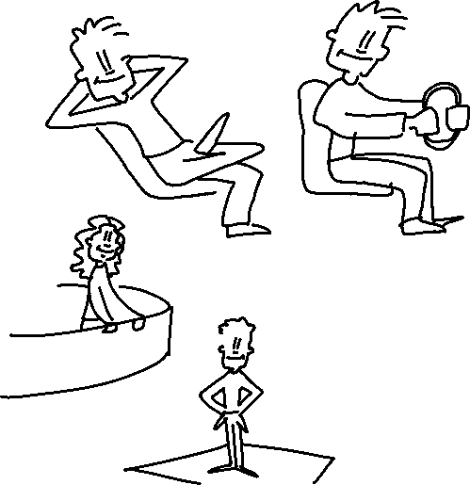


For today:
You can choose to be on CRUISE CONTROL or TAKE THE WHEEL
  Watch and observe OR try things out
We’re going to be switching between different tools and windows
  It might be clunky!
We’re going to be on the BALCONY and the DANCEFLOOR
Notes:
Brian
2min 1:09-1:11

Slide 6
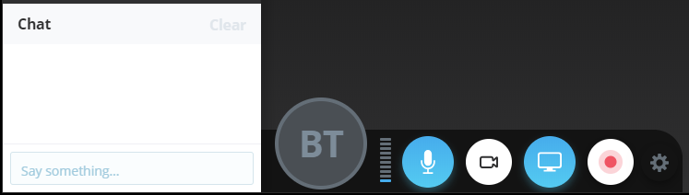


How to use GlobalMeet (was ReadyTalk)
House-keeping
Can you hear/see?
If booted out, dial/click back in
  May need to delete cache and cookies and close your browser
We are recording
Mute when not talking:
  You’ll be on mute by default
  You can unmute yourself
  If we mute you, don’t take it personally
Use Chat to ask questions and get links
GlobalMeet nuances
Web-based
  If you want to share your screen, you need to install an extension
  You can also download the app
Lag: delay between speaking and hearing, mute & unmute
Easy to join; log in as guest with passcode provided
Notes:
Erin
Mute/unmute … chat to ask questions
3min 1:11-1:14

Slide 7
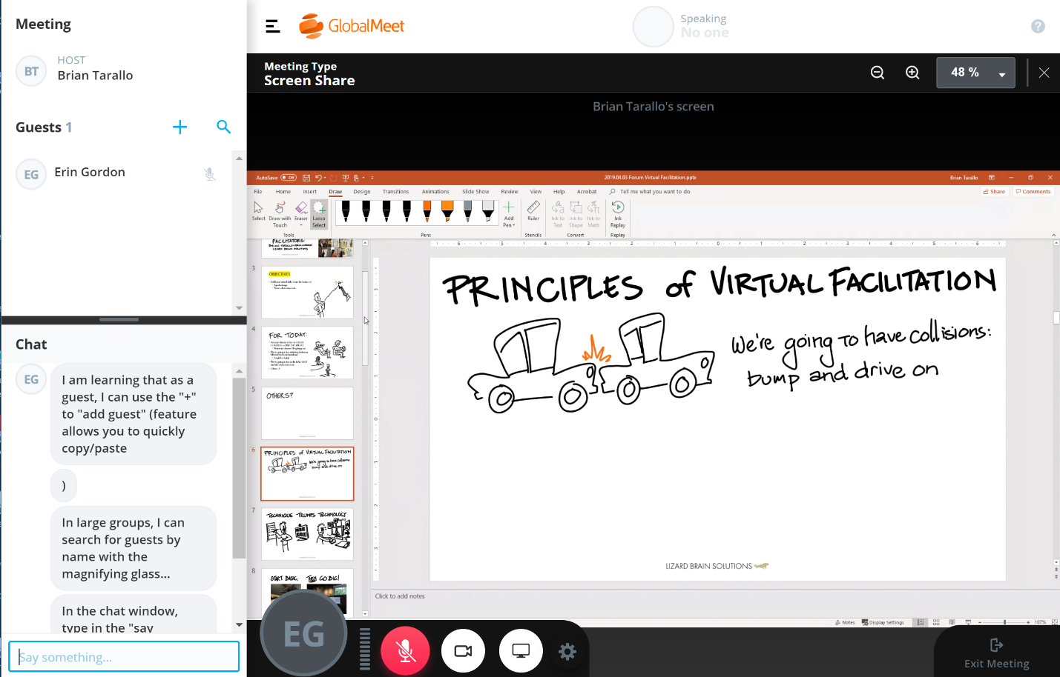













Participant View
Click to hide all meeting/chat pods
Zoom in/out (recommend scale to fill)
Click to invite guests to the meeting
Click to search guests in name list (useful for large meetings)
Right click yourself for options to manage audio/your profile. Note visual icons appear that show your “status” in grey
Click this bar to resize your chat window (e.g. expand)
Begin typing here and click enter when ready to post to chat
Mute/Unmute
Camera on/off
Screenshare Option
Settings to troubleshoot
Notes:
Erin
2min 1:14-1:16

Slide 8


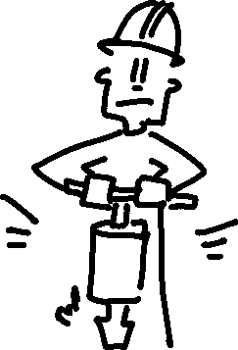







Principles of Virtual Facilitation
Notes:
Brian
One sip pauses
2min 116-118

Slide 9




Slide 10























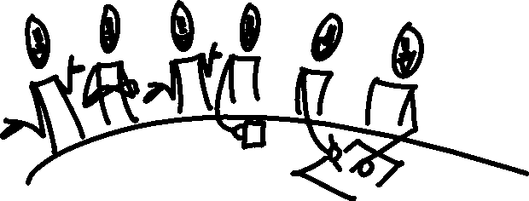
Principles of Virtual Facilitation
Notes:
Erin
2min 118-120

Slide 11















Principles of Virtual Facilitation
Notes:
Brian
3min 120-123

Slide 12


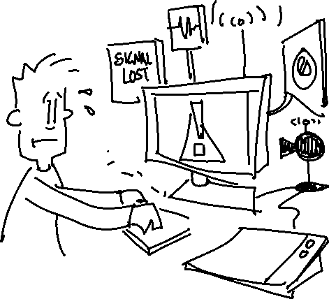












Principles of Virtual Facilitation
Notes:
Brian
1min 123-124

Slide 13
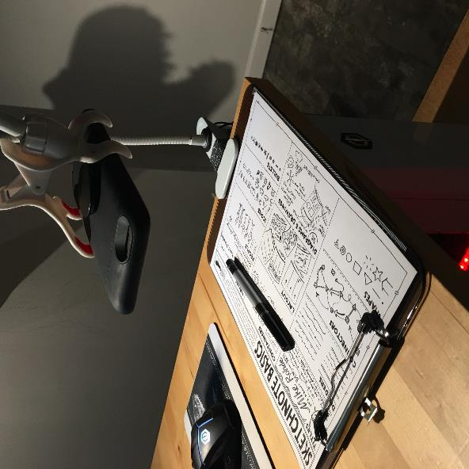
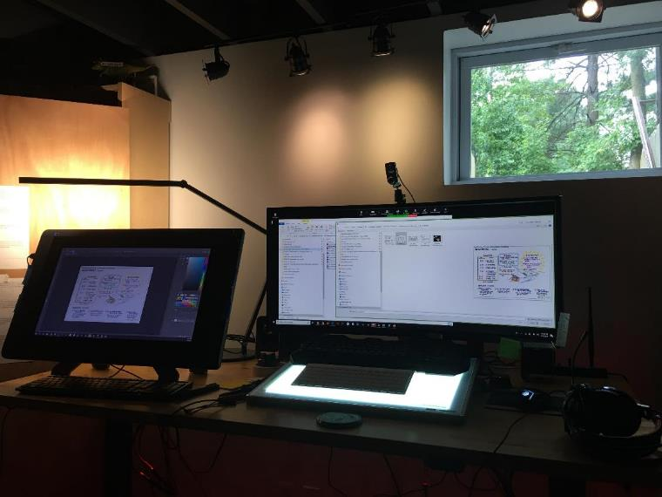








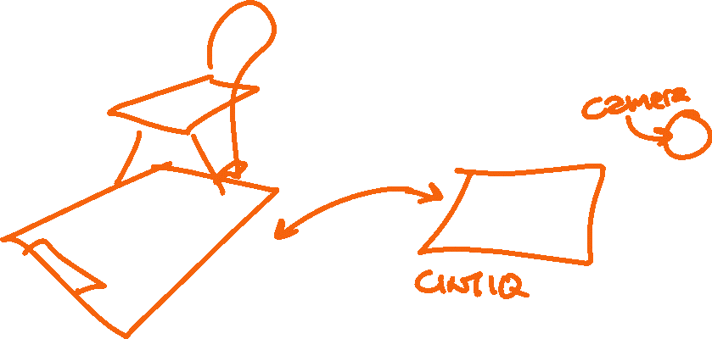
Principles of Virtual Facilitation
Notes:
Brian
2min 124-126

Slide 14






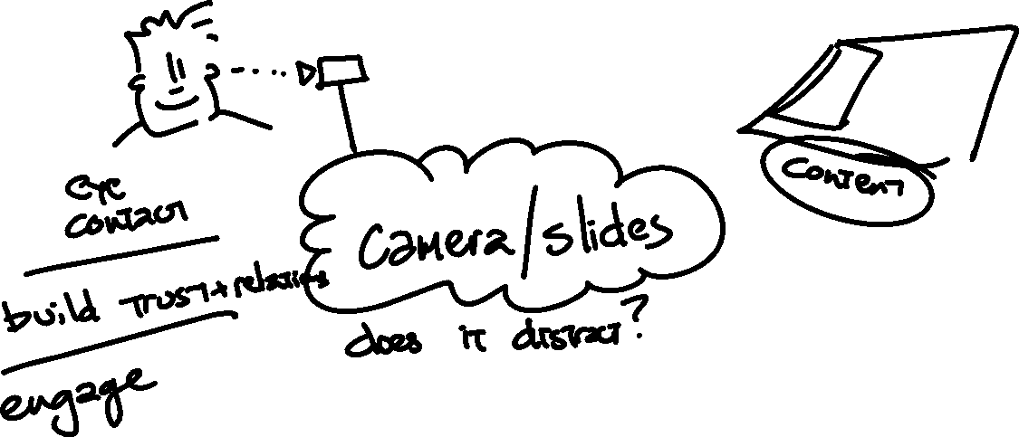




Slide 15

What’s Virtual Facilitation?
Please check your chat window for a link to this Google Doc:
  https://docs.google.com/document/d/1xJCMToZ56_ADz9VYAHs2MBc4QB3Bl1hDMQJhjEcC-O4/edit?usp=sharing
Type anywhere in the bulleted list:
“How do you define virtual facilitation?”
Add a new bullet for your answer, and try not to type on top of each other’s lines.
Notes:
Erin: post in chat
https://docs.google.com/document/d/1xJCMToZ56_ADz9VYAHs2MBc4QB3Bl1hDMQJhjEcC-O4/edit?usp=sharing
10min 126-136

Slide 16


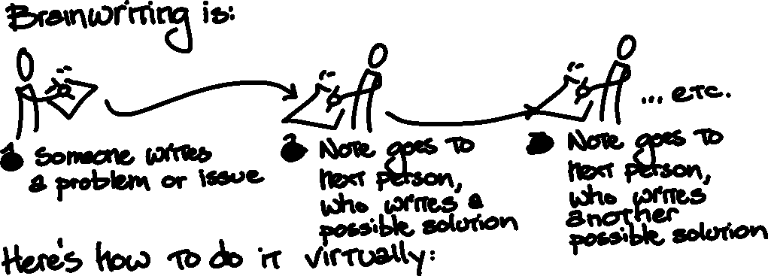

Brainwriting in Virtual Facilitation
Go to this link (in chat): https://docs.google.com/spreadsheets/d/1CTOu9e75RqUykTo36hO9DcahGdMQHKPzvHd0hFpki50/edit?usp=sharing
Write PROBLEMS you’ve seen or had with virtual facilitation
Write POSSIBLE SOLUTIONS for those problems on the same row
Notes:
Brian
15 min 136-151
Post in chat
https://docs.google.com/spreadsheets/d/1CTOu9e75RqUykTo36hO9DcahGdMQHKPzvHd0hFpki50/edit?usp=sharing

Slide 17










Slide 18







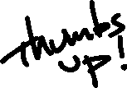


Slide 19

Virtual Facilitation Tools
Go to this link (in chat): https://docs.google.com/spreadsheets/d/11-srN2HwS_NrnXPzastiCthYj-Zu3sPmi9VusOuf4Js/edit?usp=sharing
In each row, type:
  The name of a virtual facilitation tool you use
  What it does
  The cost (if you know it)
  Pros (if you want)
  Cons (if you want)
Don’t worry about duplicating work
Notes:
Erin: post in chat
https://docs.google.com/spreadsheets/d/11-srN2HwS_NrnXPzastiCthYj-Zu3sPmi9VusOuf4Js/edit?usp=sharing
15 min 151-206

Slide 20

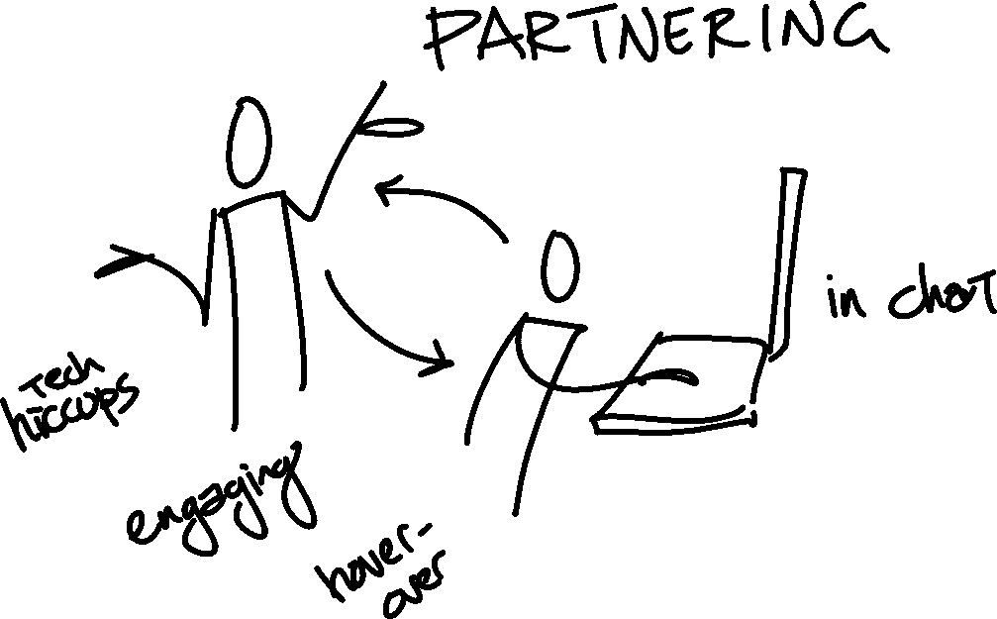

Slide 21
Agenda Design: if you have an hour to present
Timing | Activity
0:00 – 0:10 | Landing Tax / Tech Check / Center Yourself
0:10 – 0:14 | OARRs*: Outcome, Agenda, Roles, Rules
0:14 – 0:15 | Introduce presenter
0:15 – 0:45 | Presenter shares content
0:45 – 0:55 | Q&A: via chat or open mic
0:55 – 1:00 | Check outs: Share in chat: how did it go? Getting slides out to you For more information/presenter contact info How to share feedback
*OARRs is a meeting startup tool developed by The Grove Consultants International
Notes:
Brian
10 min 206-216

Slide 22











Agenda Design: if you have an hour to collaborate
Timing | Activity
0:00 – 0:05 | Landing Tax / Tech Check / Center Yourself
0:05 – 0:10 | OARRs*: Outcome, Agenda, Roles, Rules
0:10 – 0:20 | Introduce issue and invite context Capture in a Google doc or PowerPoint shared screen
0:20 – 0:30 | Brainstorm options and possible solutions Capture in a list or matrix (like a Google Sheet)
0:30 – 0:40 | Decide from among solutions and options Vote Ranked order Leader decides
0:40 – 0:50 | Plan the way ahead Action list
0:50 – 1:00 | Check outs: Communication out to others Next time to meet
*OARRs is a meeting startup tool developed by The Grove Consultants International
Notes:
Erin
10 216-226

Slide 23






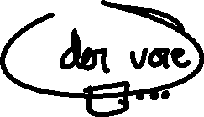


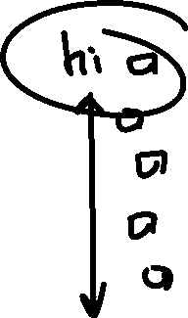



Slide 24






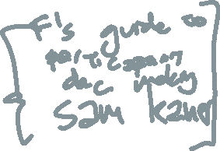






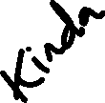




Slide 25
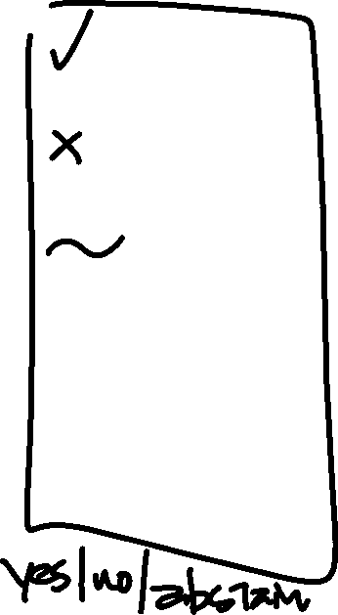






Slide 26


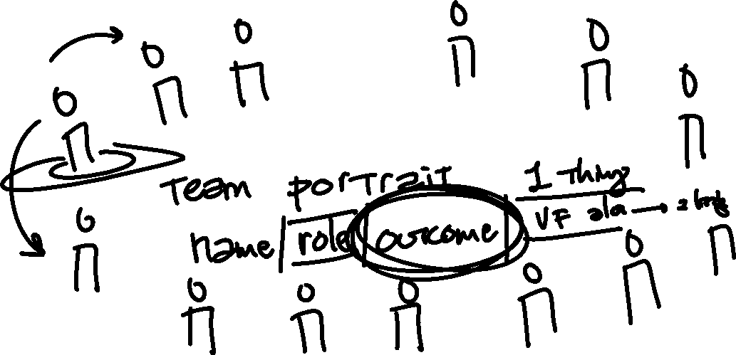




Slide 27

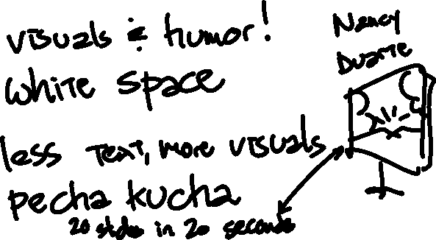

PowerPoint Best Practices
“Present” from normal view
Terrible teleprompter
Lots to communicate? Send a paper
…what else?
Notes:
Brian
10 min 226-236

Slide 28
Team Portrait name/role/outcome/1 thing
Brian – facilitator / knowledge sharing / built a canoe
Erin
Maggie
Emily

Slide 29
Gradients of agreement
1 – I hate it
2
3
4
5 – I love it

Slide 30
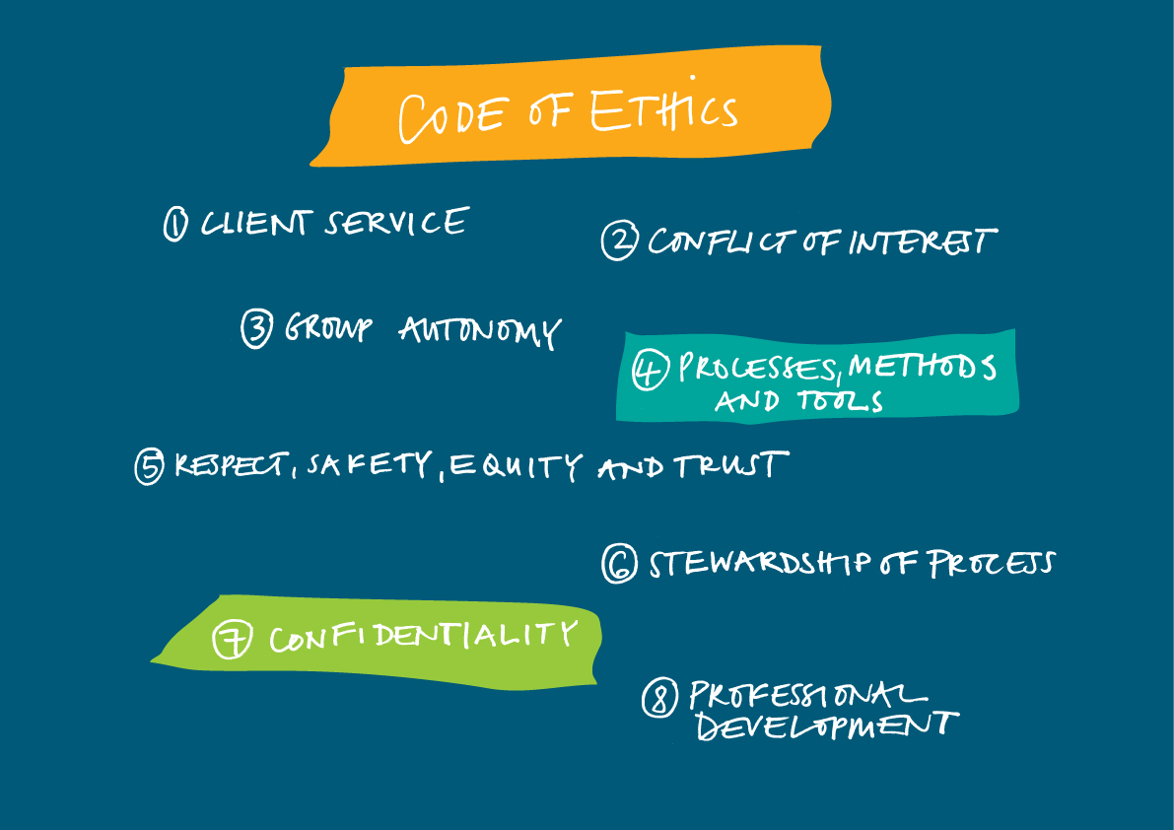
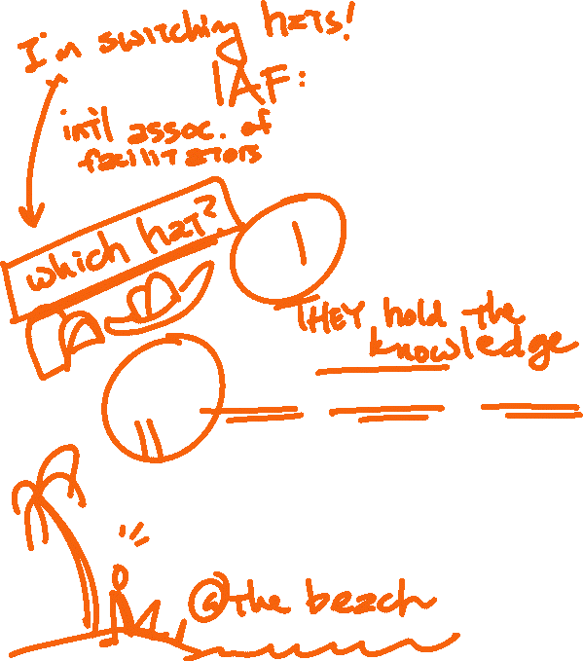















Facilitation Ethics and Values
The IAF Code of Ethics
Notes:
Erin
5 min 236-241
CODE OF ETHICS
1. Client Service: We are in service to our clients, using our group facilitation competencies to add value to their work.
2. Conflict of Interest: We openly acknowledge any potential conflict of interest.
3. Group Autonomy: We respect the culture, rights, and autonomy of the group.
4. Processes, Methods, and Tools: We use processes, methods and tools responsibly.
5. Respect, Safety, Equity, and Trust: We strive to engender an environment of respect and safety where all participants trust that they can speak freely and where individual boundaries are honored. We use our skills, knowledge, tools, and wisdom to elicit and honor the perspectives of all.
6. Stewardship of Process: We practice stewardship of process and impartiality toward content.
7. Confidentiality: We maintain confidentiality of information.
8. Professional Development: We are responsible for continuous improvement of our facilitation skills and knowledge.

Slide 31











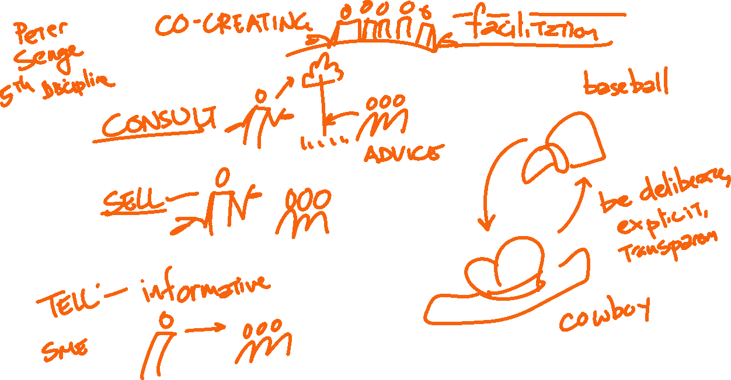






Slide 32

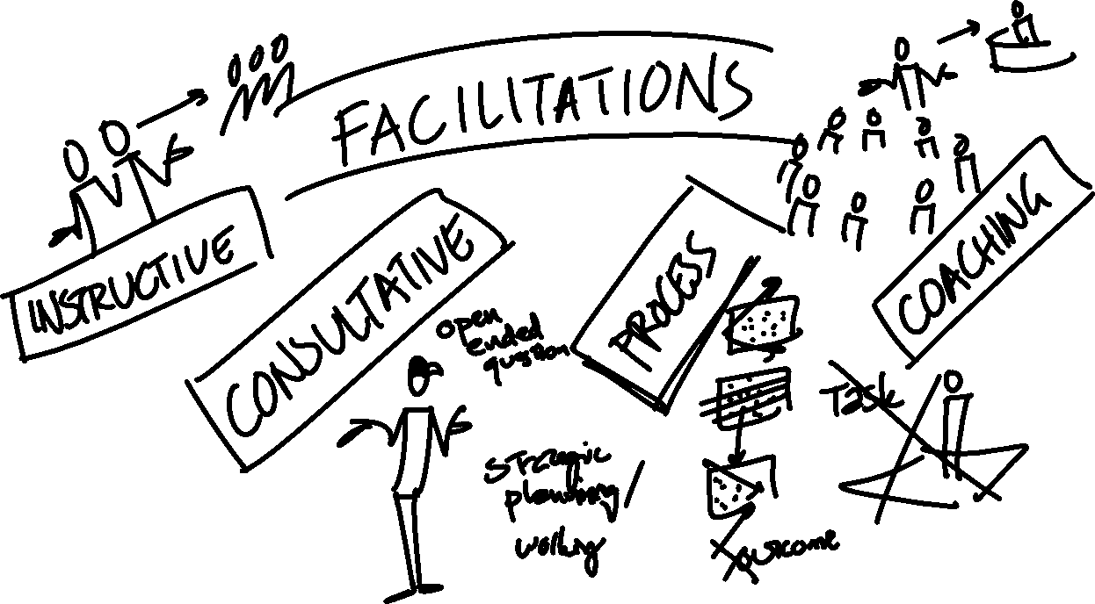

Slide 33
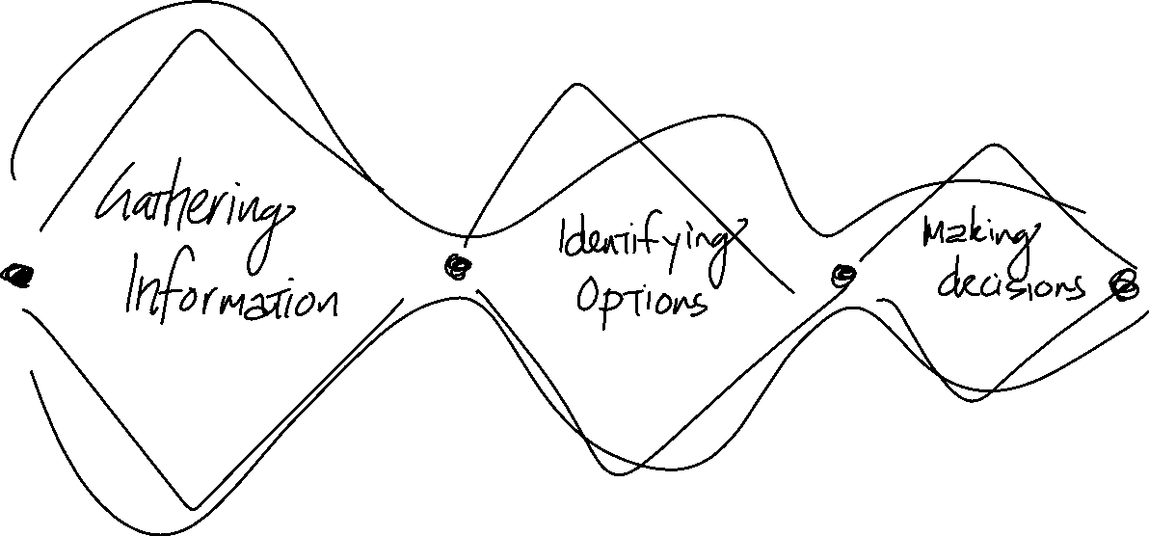

Slide 34

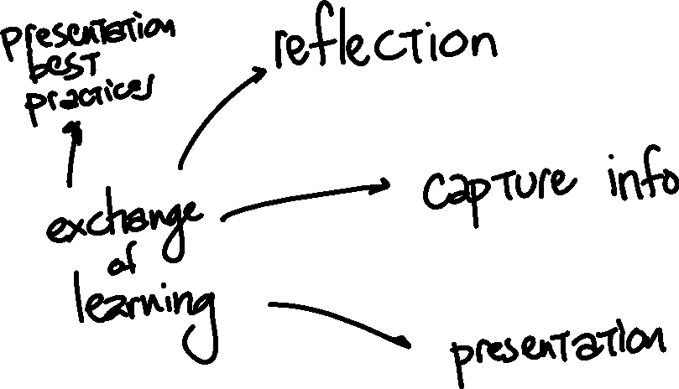


Slide 35
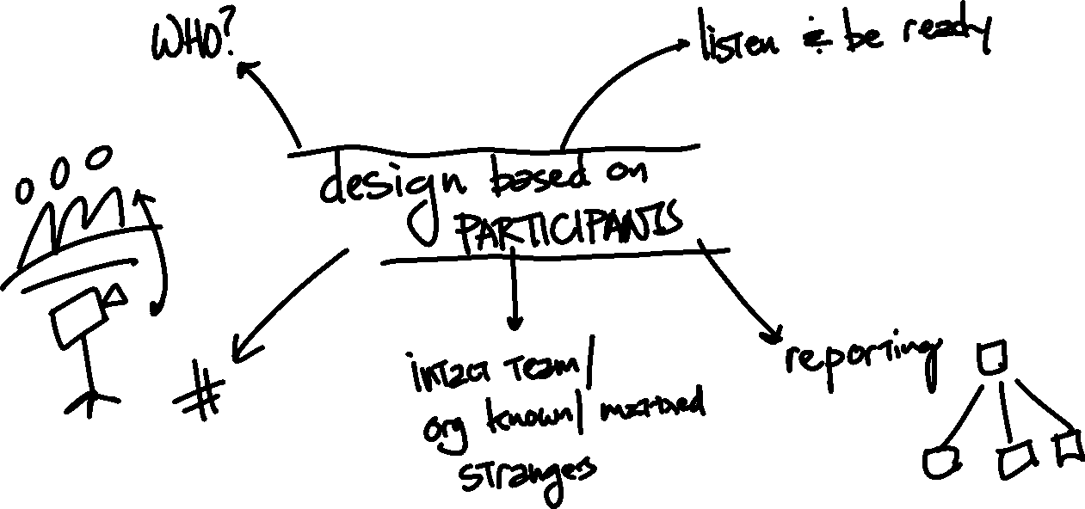

Slide 36

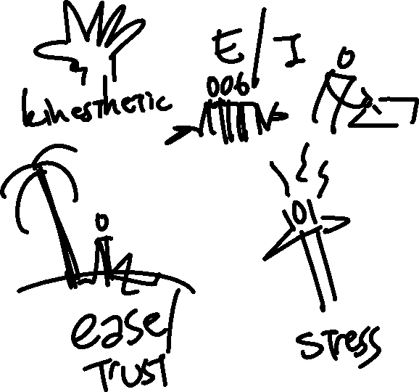







Slide 37

Facilitating through Questions
Bring in new ideas | Refining ideas | Helping people listen
“What else?” “Who else has an idea?” “Is there another perspective?” “Anyone else willing to share?” “What do others think?” “Can anyone give an example?” “Any comments from someone who hasn’t spoken in a while?” “What questions is this raising for you?” “We’ve been talking about ____. Who else has a comment?” | “Are there any other ways of looking at this?” “Does everyone else agree with this perspective?” Does anyone else have a different position?” “We’ve heard some challenges. Anyone in favor of…?” “Can anyone play ‘devil’s advocate’ for a few minutes?” “We’ve heard from A, B, and C. How about some thoughts from D?” | “What did you hear Jim say?” “Who has questions for Ed?” “Who else is resonating with what Kim said?” “What part of Bob’s idea doesn’t work for you?” “Who has a response to Jill’s comments?” “Sue, how would Tim’s idea play out in your area?” “Can you restate what Phil said?” “Can someone summarize?”
- adapted from The Facilitator’s Guide for Participatory Decision Making by Sam Kaner
Notes:
Brian
4min 241-245

Slide 38
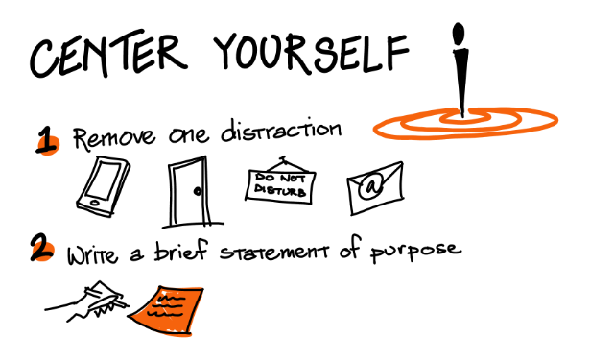
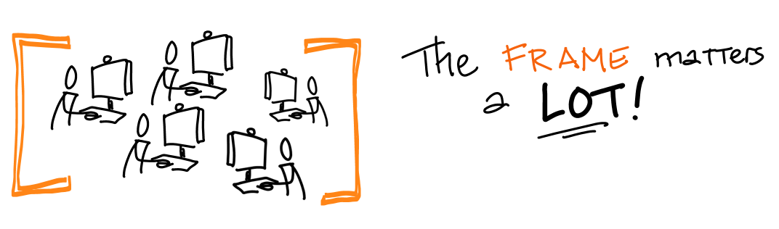




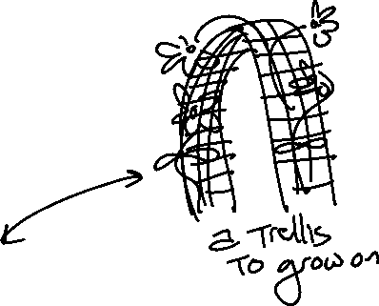


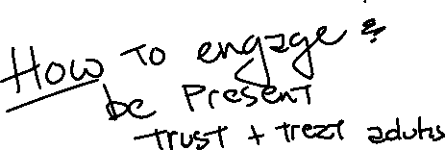
Maintaining Engagement
Notes:
Erin
5min 245-250

Slide 39
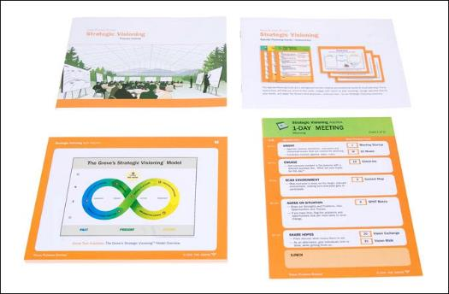

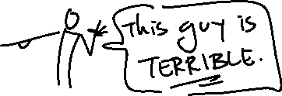
Resources
Class: Virtual Team Facilitation
  TeamCatapult, Marsha Acker
  https://teamcatapult.com/workshops/virtual-team-facilitation/
Class: Facilitating Virtual Collaboration
  The Grove Consultants, Malgosia Kostecka & Brian Tarallo
  http://www.grove.com/workshops_facilitatingVirtualCollaboration.php
Rachel Smith’s blogs
  http://news.grove.com/author/rachelsmith/
  http://digitalfacilitation.net/
Visual Templates
  Grove’s Strategic Visioning templates
    https://grovetools-inc.com/collections/digital-graphic-guides-v-4-0
  Think With Ink
    http://lizardbrainsolutions.com/think-with-ink/
Us! brian@lizardbrainsolutions.com
eng@erinicolegordon.com
Notes:
Erin
5min 250-255

Slide 40


How’d it go?
In the Chat, write one or two words to describe today’s workshop.
Notes:
Brian & Erin
Any remaining q&a
255

